Slide 1
UCLA PS Methods Field!

Slide 2
You might not know it yet but….
Methods is THE coolest field in the world!
Yes, I am biased…
(I need to be controversial and bold)
You might be a bit unsure about what we do, a bit skeptical about our approaches, maybe even nervous about what we teach, and most likely think that we are too nerdy
I am not going to challenge that last part…
But give me a chance to help with the other issues!

Slide 3
Reasons to join the methods group
“It is not relevant for my research”
‘In God we trust. All others must bring data.’ – W. Edwards Deming
Also, you develop skills that allow you to interact with other work/fields
“I don’t trust machines”
Neither do I. But use them to help you!
“I don’t think I want or can develop methods”
You don’t have to. My favorite part of political methodology is the “political” part.
“It is too hard!”
Do me a favor and forget what your third grade Math professor told you. We are all here to learn.
”Methodologists are weird”
Touché. But we are fun!

Slide 4
Kinds of methods courses
Formal theory (Flavors: social choice theory, game theory, structural models, …)
Statistics
Qualitative methods
Specific methods relevant to particular topics or specialities e.g. ideal points, social network analysis

Slide 5
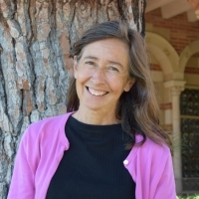
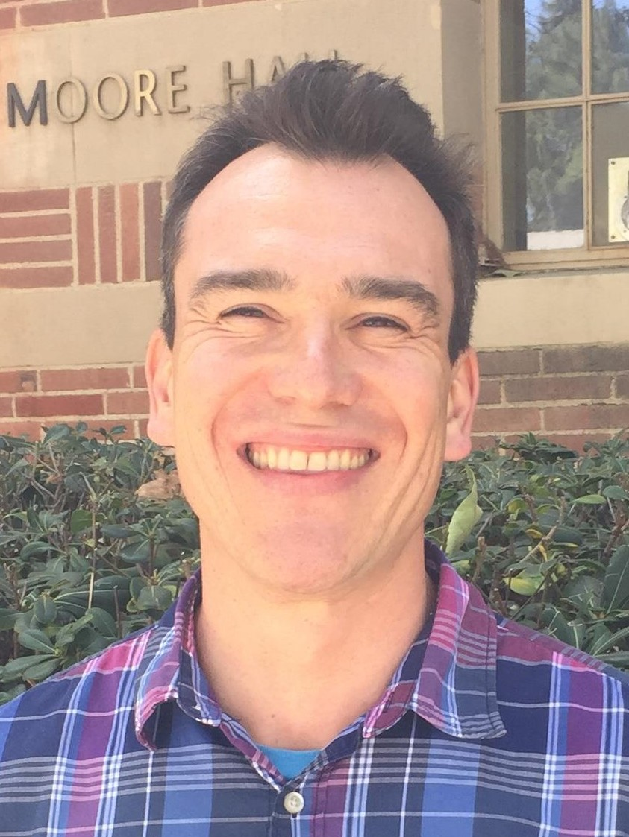
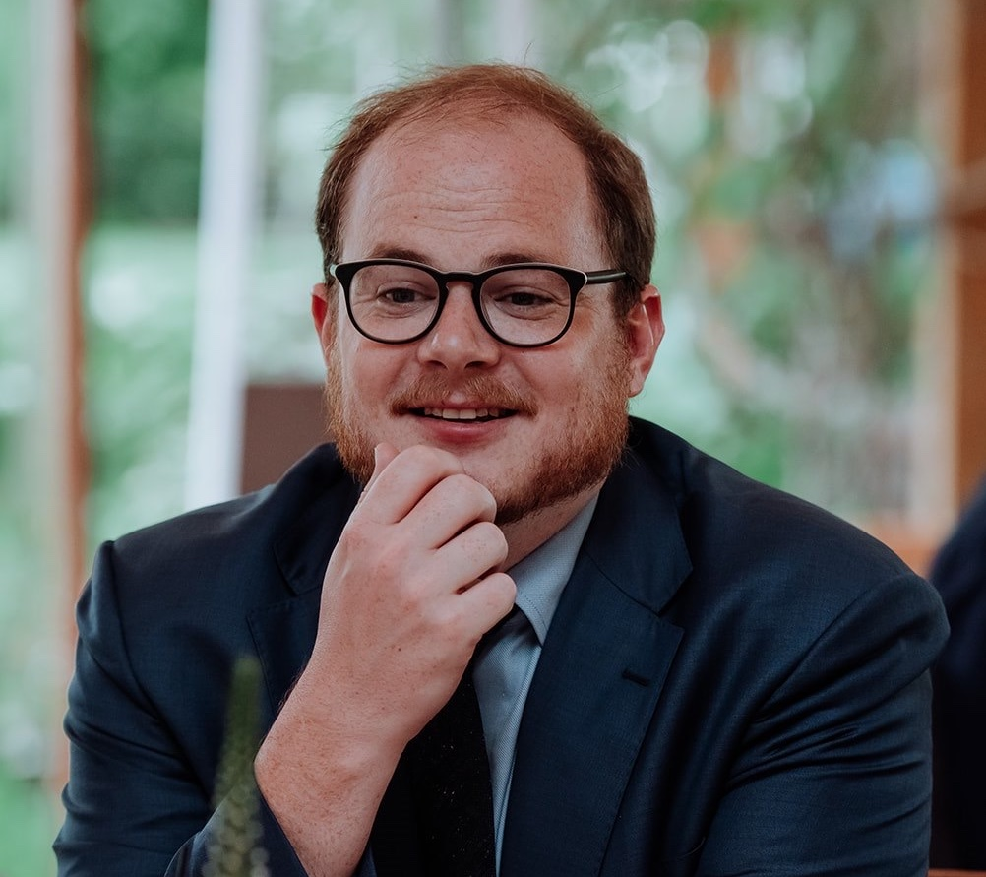
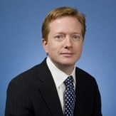
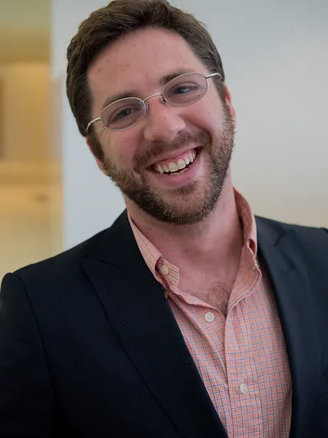
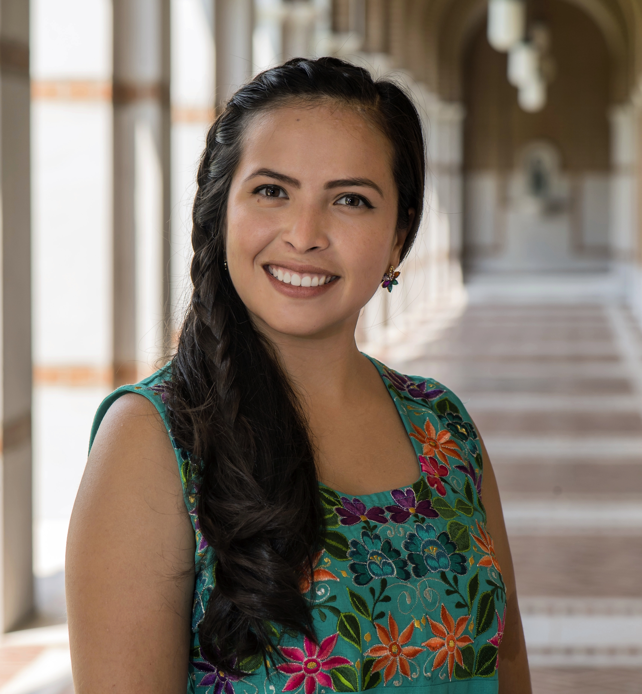
Kathy Bawn (200A) is a scholar of political parties. She uses formal theory and statistics, and teaches both.
Ozan Jaquette is an economist in the School of Education who teaches “Everyone Can Cook,” a social science-wide course on coding for first year Ph.D. students.
Graeme Blair studies crime and violence — and how to improve social science research designs, including using field experiments and surveys.
Jeff Lewis studies US legislative politics and how we can learn about them using data including the votes of members of Congress.
Chad Hazlett studies conflict and causal inference and develops methods for answering questions that are hard (or impossible) to study with randomized experiments.
Michelle Torres studies political communication and behavior. She uses computational methods, in particular computer vision, to analyze the role of images in the political communication process.
Also: Luwei Ying and Eric Min (computational methods in IR), Jonathan Homola (causal inference in CP), Dan Thompson (natural experiments in AP)

Slide 6
Statistical methods sequence
200A: Probability and statistics (Fall Y1) EDUC 260A: Anyone can cook (intro. to programming and data analysis) (Fall Y1) [optional] EDUC 260B: Anyone can cook 2 (adv. coding) (Winter Y1) 200B: Regression (Winter Y1) 200C: Causal inference (Spring Y1) 200D: Maximum likelihood (Y2) 200E: Experimental design (Y2) 200F: Variable topics e.g. bayesian stats. or computational social science (Y2/Y3)
More: social networks and politics (Cesi), research design for CP (Dan Posner), research design planning (me), …

Slide 7
Should you take statistical methods courses?
You want to use data analysis in your research (this is our primary target)
You don’t, but you want to be able to engage with and build on past quantitative research
You want to develop new research designs and statistical methods
Which courses to take? Except in rare exceptions (happy to chat!), start with 200A and Ed 260A
Do not recommend GIS course (come talk to me)
Undergrad. courses (math, CS, stat.)

Slide 8
Who can succeed in these courses?
We want our courses to be accessible to all students who are willing to work hard and a positive attitude, regardless of your previous experience with statistics
This is a commitment we take really seriously — and an ongoing, imperfect effort
Our primary goal is to provide the tools needed to execute research designs that can deliver credible answers to the questions you ask in your dissertation project and research agenda
Basic probability and statistics, introduction to a range of common research designs, and learning-by-doing coding to implement the tools
And also to provide tools that the non-academic market value (i.e. data analysis skills)
We are here to help, so visit us!

Slide 9


Slide 10
Articulated degree program in PS and statistics (MA -> MA -> PhD)
Statistics coursework at a more fundamental level
MA thesis supervised by a statistics prof. (often published in great journals, or second job market paper)
You want to adapt methods to answer your applied questions
You want to build new methods as a “methods second” scholar
You want to build new methods as a “methods first” scholar
You are an applied researcher but you enjoy statistics
It takes some time and effort: talk to us and to to other students working on it.

Slide 11
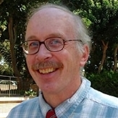
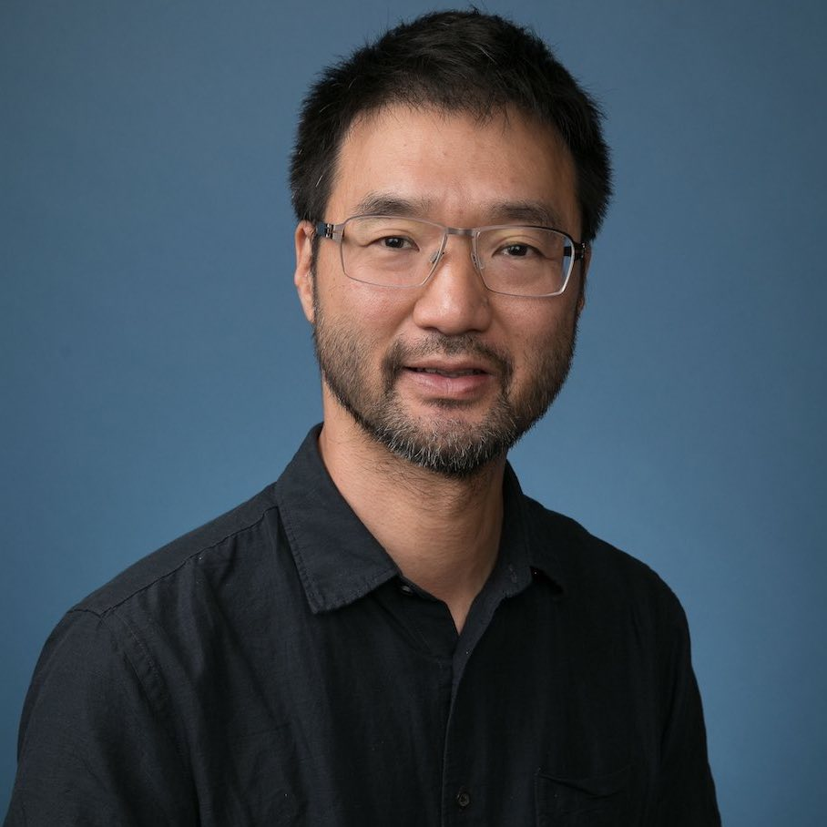
Formal theory courses
204A: Introduction to game theory (Y1/Y2) 204B: Advanced game theory (topics) (Y1/Y2)
Barry O’Neill studies strategic interactions in IR and nuclear politics. He uses and teaches game theory for grads and undergrads.
Michael Chwe uses game theory to study how people work together collectively to cause social change and teaches at the grad and undergrad level.

Slide 12
Should you take formal theory courses?
You want a toolkit for understanding the strategic actions of political actors in a structured way
You want to build formal models in your research (as a formal theorist or an applied researcher who includes models as part of empirical papers)
You want to be able to read models to build on their insights in your work

Slide 13
How to get help
Your professor and TA (in 200A, 200B, 200C, and 200E)
Math maven (regular office hours)
R maven (regular office hours)
Your cohort! (Form a study group)
Free online resources (I will email list later today)
Confidential discussion of challenges you’re facing (my office hours!)

Slide 14
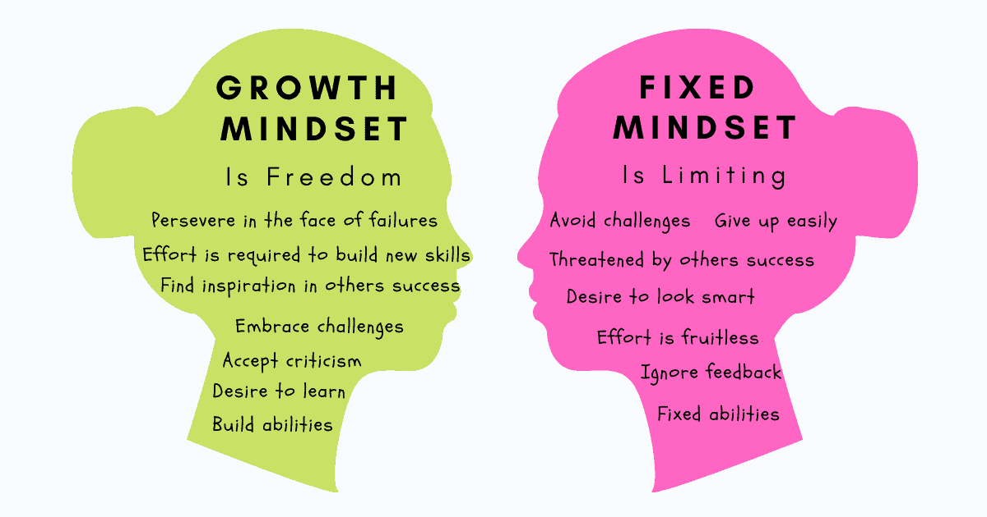

Slide 15
More questions?
Contact me (but be patient!)
These slides are in my Github page:

